Slide 1
Introduction to Machine Learning
Gaurav Moghe
Assistant Professor, Plant Biology
PLSCI 7202

Slide 2
Overview of the lectures
Day | Lecture 1 | Lecture 2
1 (Wed) | Intro to ML | Examples of ML application to genomics and plant science
2 (Fri) | Intro-continuation | WEKA Dataset 1: Compound classification
3 (Mon) | Intro to Python packages for ML (Pandas, Matplotlib, Seaborn, NumPy, Scikit-learn) Dataset 1: Compound classification
4 (Wed) | Intro to Deep Learning | PyCaret for classification Dataset 2: Gene function prediction Dataset 3: Nutrient prediction

Slide 3
Learning goal
To expose you all to terminologies or concepts
For more in-depth explanation of concepts, wait for Chris’ lectures!!

Slide 4
Overview of this lecture
General overview of ML algorithms
Introduction to ML concepts
Types of ML
Specific algorithms for feature-based ML
Supervised
Unsupervised
Judging which model is best

Slide 5
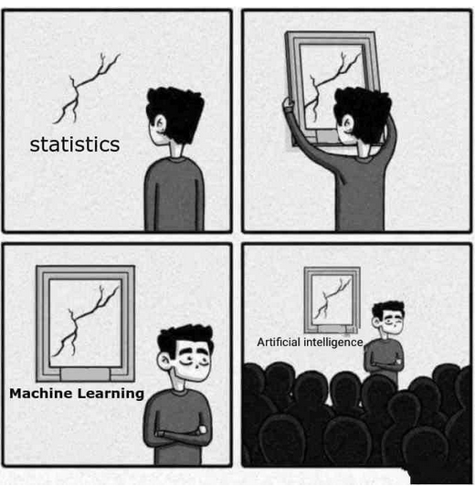
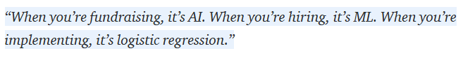
What is Machine Learning?
Is Machine Learning just glorified statistics?
Learning is the acquisition of knowledge or skills through study, experience of being taught (Oxford Dictionary)
Machine learning (ML) is the scientific study of algorithms and statistical models that computer systems use to effectively perform a specific task without using explicit instructions, relying on patterns and inference instead.
https://towardsdatascience.com/no-machine-learning-is-not-just-glorified-statistics-26d3952234e3
Notes:
In many cases, these algorithms are completely useless in aiding with the understanding of data and assist only in certain types of uninterpretable predictive modeling. In some cases, such as in reinforcement learning, the algorithm may not use a pre-existing dataset at all. Plus, in the case of image processing, referring to images as instances of a dataset with pixels as features was a bit of a stretch to begin with.

Slide 6
How is ML different from statistics?
Property | Statistics | ML
Origins | Mathematics | Computer science
Purpose | Mostly explanatory and interpretation of relationships between variables | Interpretation sacrificed for predictability
Data types | Statistics can be performed with a single variable and with a handful of samples (low dimensional problems) | ML is worthwhile only when there are many variables (features) for operation, and hundreds to millions of samples (high dimensional problems)
Data collection | Need to understand properties of data very well | Algorithm figures everything out in many cases

Slide 7
Example ML tasks in biology
Classification
Classifying a sequence into protein-coding/RNA/transposons
Classifying a diseased plant from a non-diseased one
Classifying cancerous tissue from a non-cancerous ones
Regression
Yield of a maize plant upon maturity based on seedling Txtome
Transcript FPKM level based on sequence
Stock price based on previous market data

Slide 8
Some important terms in ML field
Features, instances, labels
Bias and variance
Loss/cost functions
Hyperparameter tuning
Regularization
Cross-validation

Slide 9
Important terminology about training data
CLASS/LABEL
FEATURES
PLAY? | HUMIDITY | WINDY? | OUTLOOK
YES | 90 | NO | RAIN
YES | 85 | NO | OVERCAST
YES | 80 | NO | RAIN
YES | 70 | YES | OVERCAST
YES | 65 | YES | OVERCAST
YES | 60 | NO | SUNNY
YES | 50 | NO | RAIN
YES | 45 | YES | SUNNY
YES | 40 | NO | OVERCAST
NO | 95 | YES | SUNNY
NO | 90 | YES | SUNNY
NO | 80 | NO | SUNNY
NO | 45 | YES | RAIN
NO | 30 | YES | RAIN
Binary classification
Multi-class classification
Multi-label classification
INSTANCES

Slide 10
What type of ML should you be doing?
Mahood et al, Applications in Plant Sciences, 2020

Slide 11
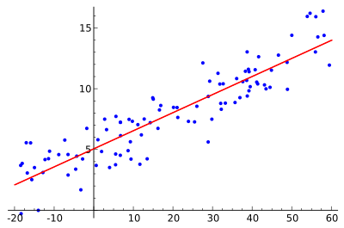
Loss function
A simple predictive model
Measure squared error of each point from the regression line
Minimize the sum of squared error (SSE)
y=mx+c
The model learns:
Slope
Intercept (bias)
Brute force
Gradient Descent
(different types)
Evolutionary algorithms

Slide 12
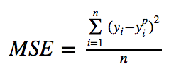
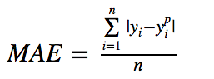
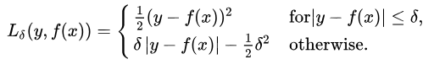
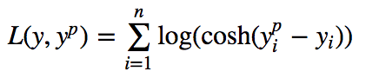
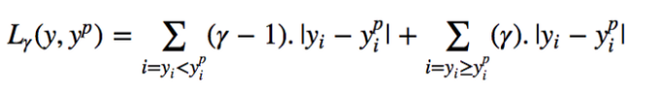
Different types of loss functions
L2 loss
L1 loss
Huber loss
Log-Cosh loss
Quantile loss
https://heartbeat.fritz.ai/
Custom function?
Predict the optimum time to reach an exam venue
Notes:
Squared errors – easy to solve, but gives more weight to outliers. Nonetheless, preferred s
Absolute error – more robust to outliers
Custom function example – when is the optimum time to reach the class?

Slide 13
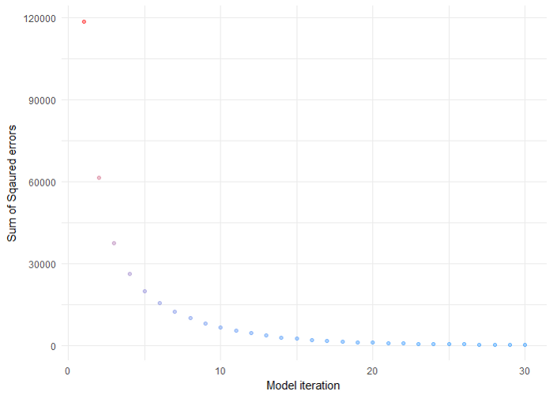
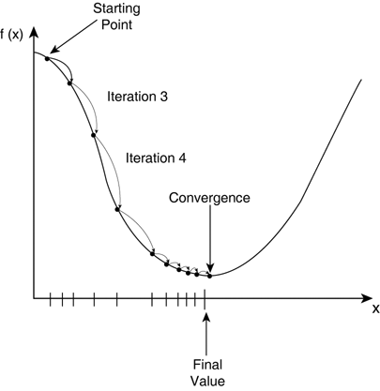
Minimizing the cost function using Gradient Descent
TDS
How many steps should I advance each time?
Learning rate
Should I sample the whole space of each parameter?
Grid search vs. random search
TDS
y=mx+c

Slide 14

Gradient descent can lead you to a local minima
techTalks

Slide 15
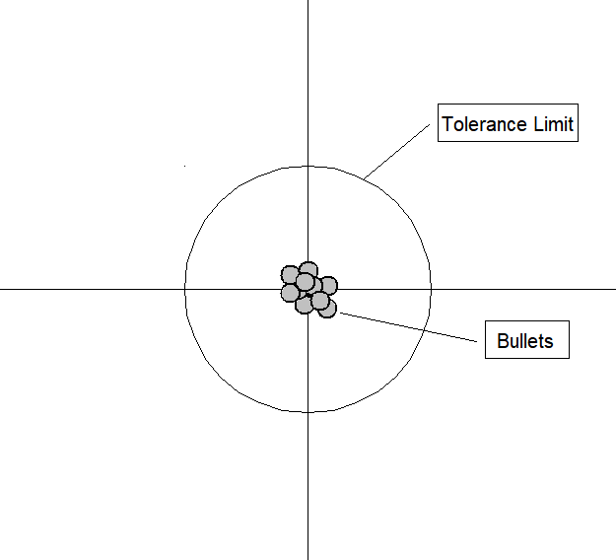
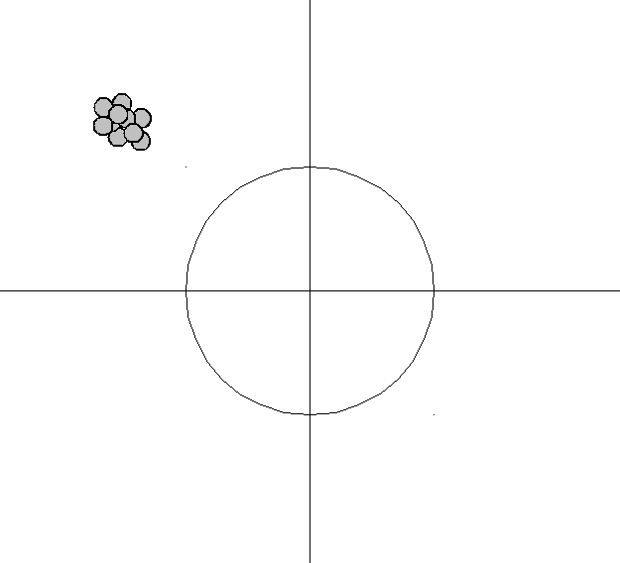
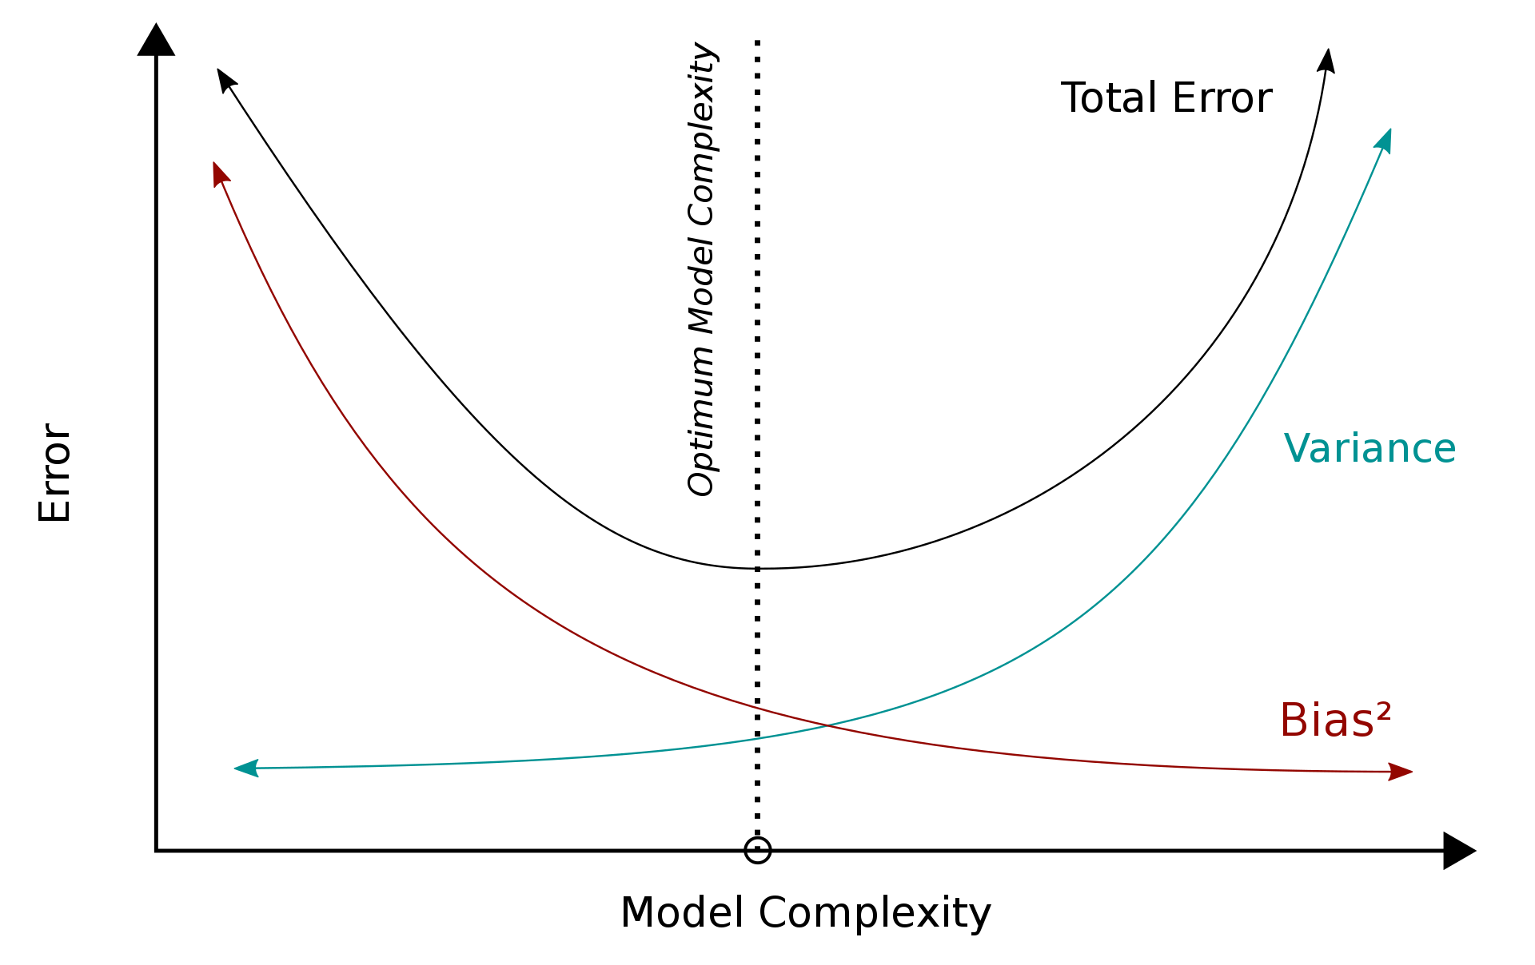
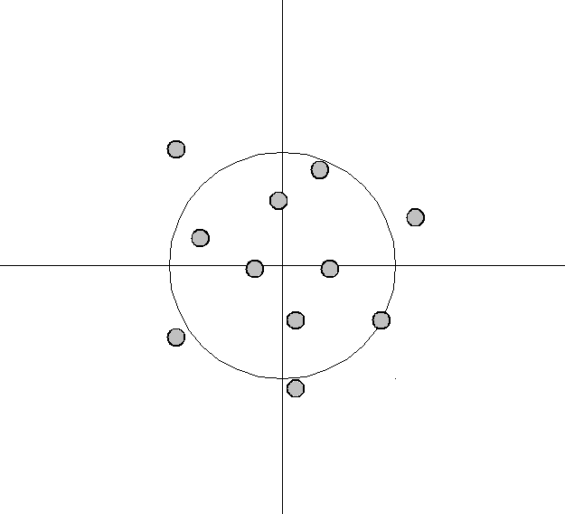
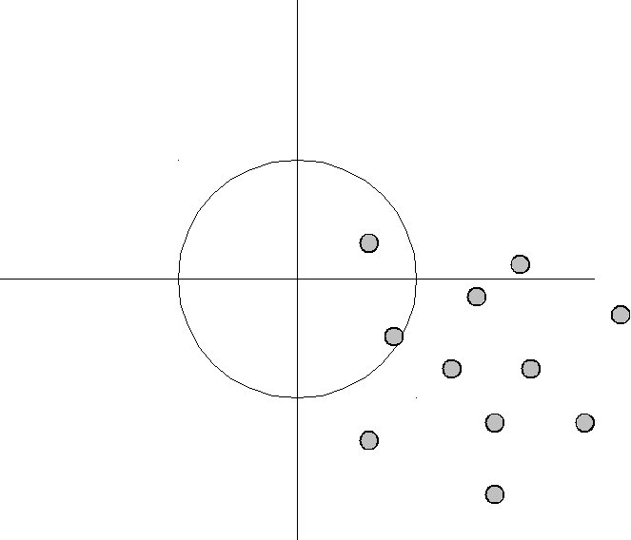
Bias and Variance
Similar to accuracy and precision
Bias: Leads to consistent errors
Variance: Leads to incorrect predictions

Slide 16
Algorithms to be discussed
Supervised
Linear Regression
Logistic Regression
Decision Trees
Random Forest
Bagging and Boosting
Support Vector Machines
Unsupervised
K-means Clustering
Principal Components Analysis

Slide 17
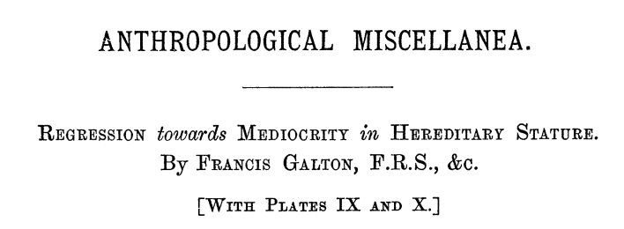
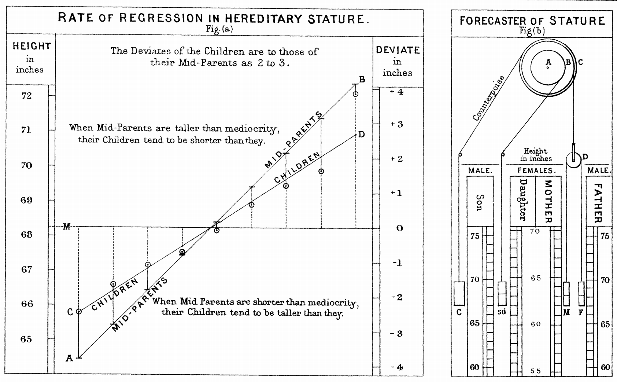
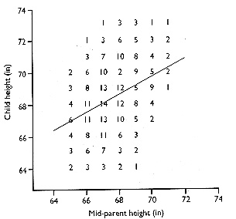
Linear Regression – I Why does regression mean?

Slide 18
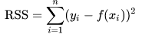
Linear regression - II
What happens when there are three variables?
y
(e.g. Shoot length)
Error in predicting y
Regression line
Intercept
The ”sigma” is nothing but a for loop
x (e.g. soil N content)
rss = 0
for x in xlist:
y_actual = dict1[x]
y_pred = f[x]
error = (y_actual – y_pred)
rss += (error*error)
L2loss = rss/len(x)
y = Slope*x + intercept
y = mx + c
y = m₁x₁ + m₂x₂ + c

Slide 19
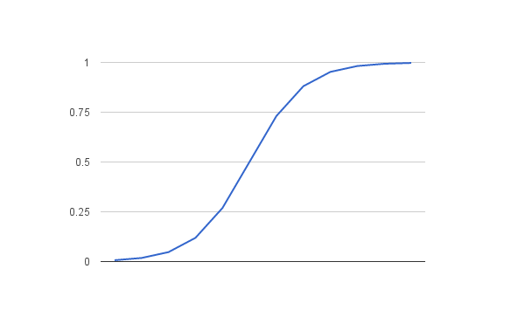
Logistic Regression – II What is logistic regression?
Unlike linear regression, logistic regression is used when the dependent variable is binary (yes or no)
Logistic regression can take both categorical and continuous data, hence, finds use in many ML applications
Example:
What is the probability that the plant is experiencing Phosphate deficiency given conc. of X₁, X₂, X₃, X₄… metabolites
Yes
Probability
No
Feature value
Logistic function
Thought to be named so, to show distinction from logarithmic function

Slide 20
Other regression-based approaches
Ridge regression
LASSO regression
Elastic Net regression
Polynomial regression

Slide 21
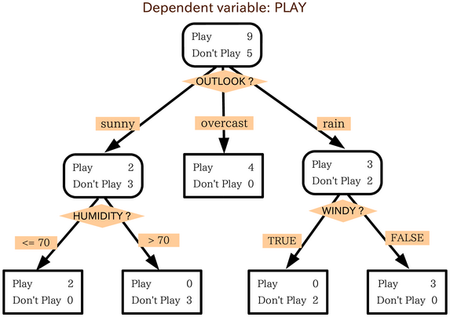
Decision Trees
CLASS | HUMID-ITY | WINDY? | OUTLOOK
PLAY | 90 | NO | RAIN
PLAY | 85 | NO | OVERCAST
PLAY | 80 | NO | RAIN
PLAY | 70 | YES | OVERCAST
PLAY | 65 | YES | OVERCAST
PLAY | 60 | NO | SUNNY
PLAY | 50 | NO | RAIN
PLAY | 45 | YES | SUNNY
PLAY | 40 | NO | OVERCAST
DON'T | 95 | YES | SUNNY
DON'T | 90 | YES | SUNNY
DON'T | 80 | NO | SUNNY
DON'T | 45 | YES | RAIN
DON'T | 30 | YES | RAIN
Pure node
Simplest algorithm
Generally results in poor performance
Easy to overfit AND underfit
Imbalanced datasets affect it substantially
Feature at each node is decided by metrics such as Information Gain, Entropy, Gini Impurity etc.

Slide 22
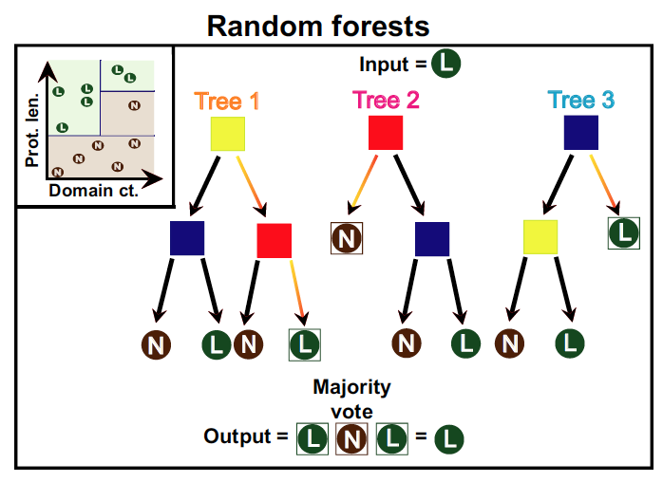
Random Forests
Randomly sample features and instances with replacement
Make a decision tree using those split sets
Repeat (bootstrap)
Make predictions for each instance based on majority voting (aggregate)
Bootstrap aggregation: Bagging

Slide 23
Variations on the general tree approach
Weighted Weak Learners
Adaptive boost (Ada boost)
Gradient boost
Light gradient boost
Extreme gradient boost (XG boost)
CATboost
Both bagging and boosting are intended to minimize errors due to variance in data
Each tree is made independently for bagging, while for boosting, new tree depends on old tree
Make a small tree or a stump
Make predictions of the labels in the training data
Calculate tree error
Make new tree to minimize error

Slide 24
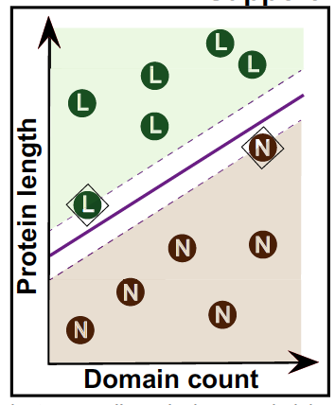
Support Vector Machines (SVM)
Support Vector Classifier aims to separate the two (or more) classes with a boundary that maximizes the distance from the support vector
Sometimes, such boundaries cannot be drawn clearly.
SVMs come into play here.
SVMs use kernel functions that transform the data into higher dimensions (e.g. squaring the values), where, maybe a classifier can be found.
Linear, polynomial, radial kernel functions use a mathematical approach called kernel trick to find the classifier without really transforming the data into higher dimensions
Support Vector Classifier

Slide 25
Algorithms to be discussed
Supervised
Decision Trees
Random Forest
Boosting and bagging
Logistic Regression
Support Vector Machine
Unsupervised
Principal Components Analysis
K-means Clustering

Slide 26
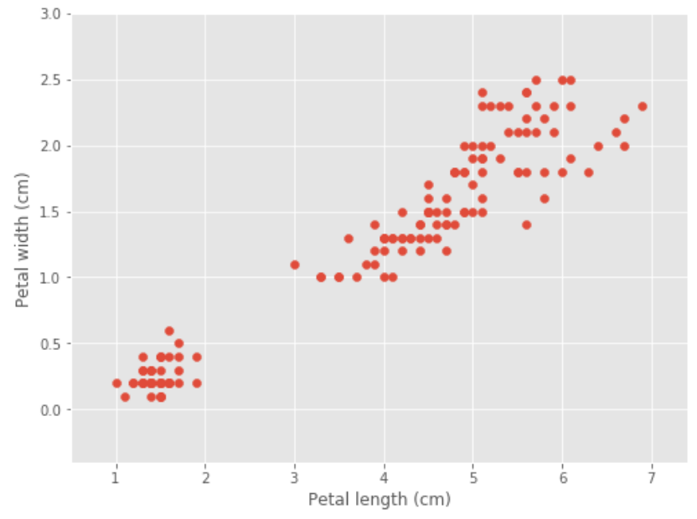

K-means clustering
The Iris dataset
setosa
verisicolor
virginica
Goal: Find out optimal clusters that represent the three flowers using two features
https://blog.easysol.net/machine-learning-algorithms-3/

Slide 27
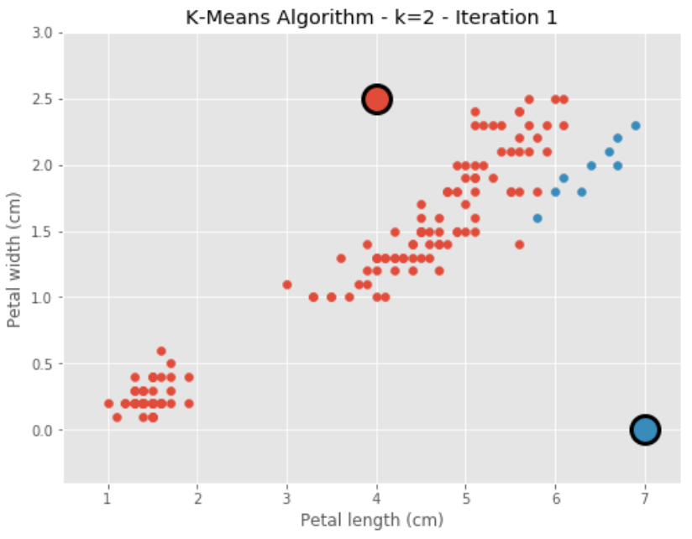
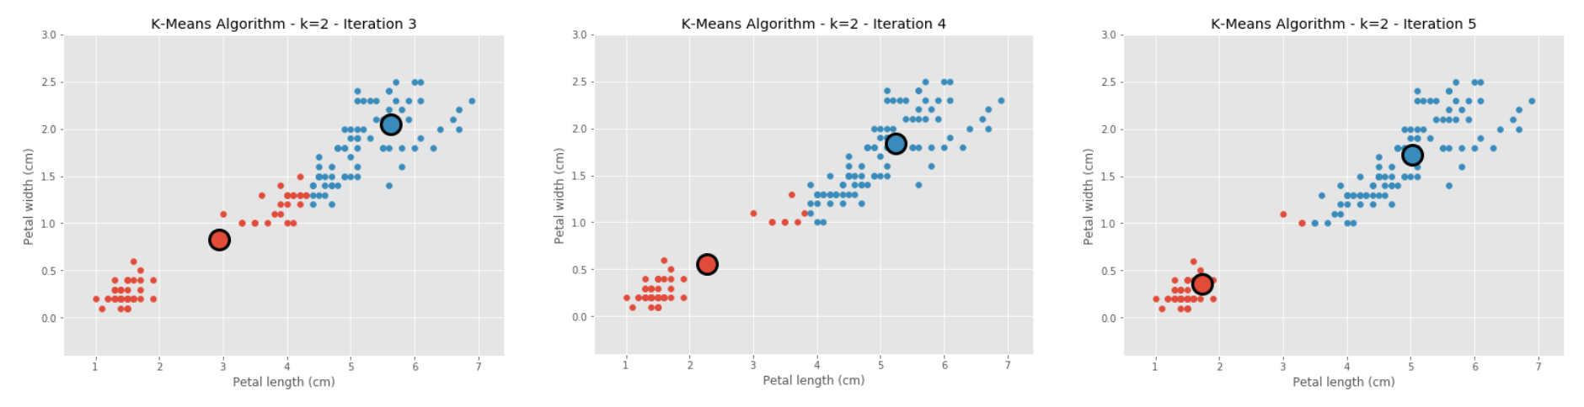
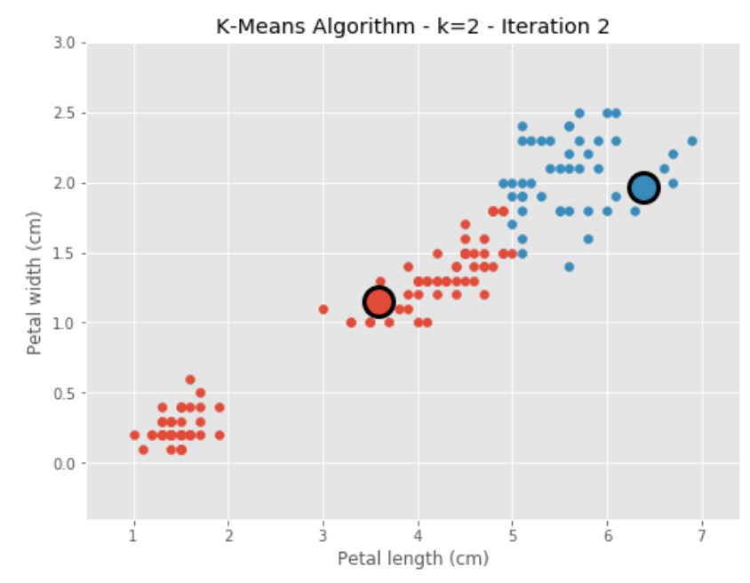
K-means clustering
Specify the number of clusters required (k=2)
Calculate distance from cluster point to every point in the distribution of values
Assign points to a cluster based on the closest distance
Find centroid of those points
Place new cluster center at that point
Repeat till no change in centroid value

Slide 28
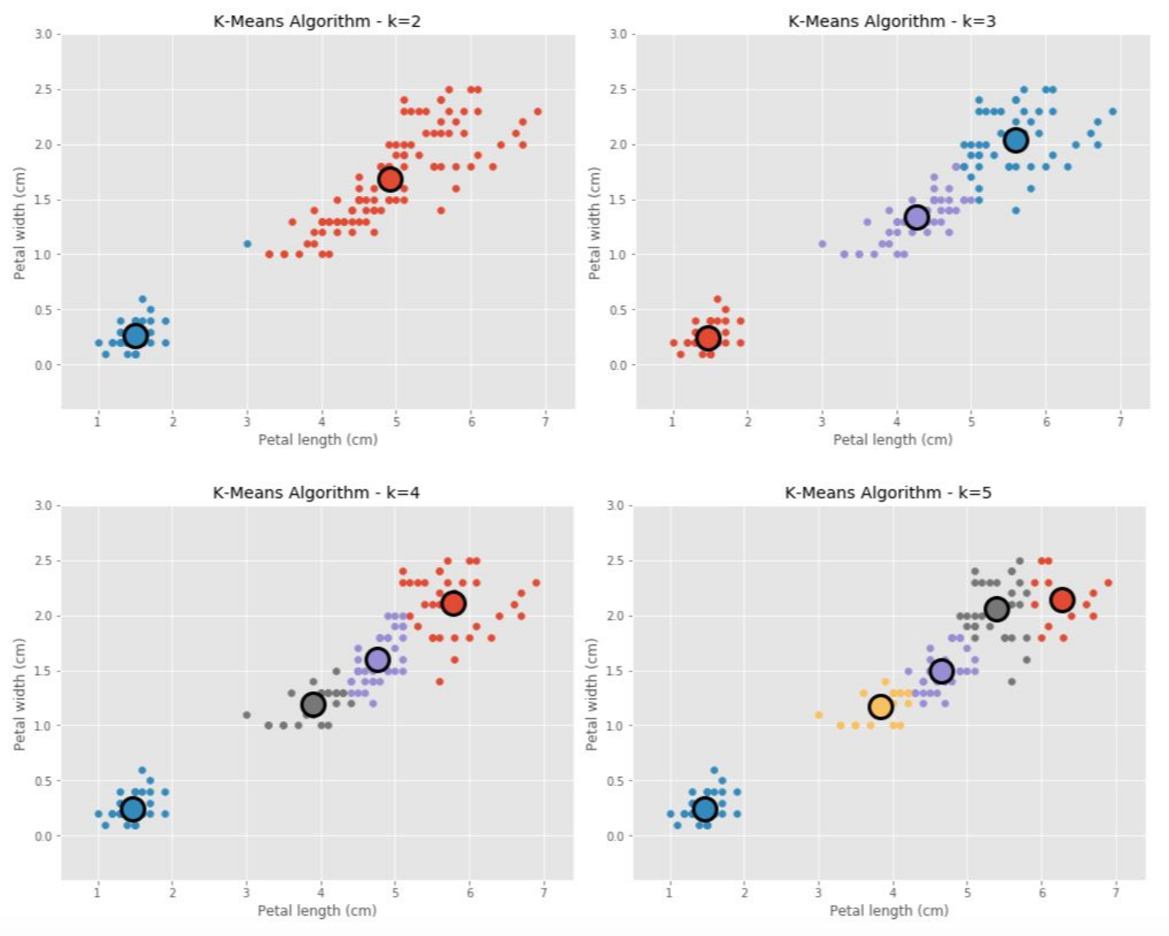
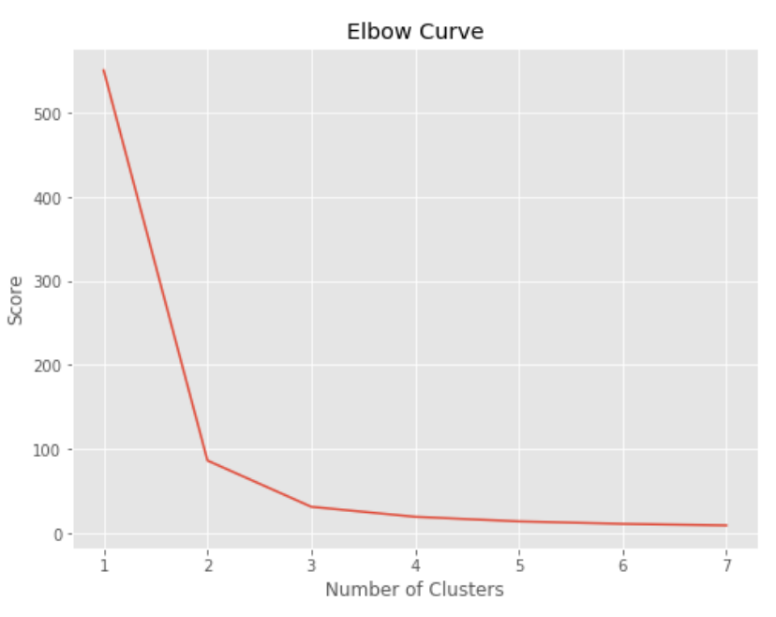
K-means clustering using different k values
Repeat k-means clustering for multiple values of k
Calculate sum of squared errors (SSEs) for every value of k, and plot it
K with very little change going to k+1 clusters is the most optimal

Slide 29
PCA – Basic concept
Transforming distribution of data into another scale based on variance
Transform
Gene 1 FPKM
PC1
Highest variation
Gene 2 FPKM
PC2

Slide 30
PCA with 3 and more genes
Transform
Gene 1
Gene 3
PC1
Gene 2
PC2
Eigenvalue: Sum of squared distances of each point on a given PC
Loading scores/Eigenvectors: How the original values are projected on a given PC
If you have 30K genes, you’d have 30K PCs
Need to check how much variation is explained by the first two PCs
If high proportion is explained in 2 axes, make XY plot
Clustering may be easy, but results are difficult to interpret
Notes:
One of the best explanations of what eigenvectors are: https://wiki.pathmind.com/eigenvector

Slide 31
Overview of this lecture
General overview of ML algorithms
Types of ML
Specific algorithms for feature-based ML
Supervised
Unsupervised
Judging which model is best

Slide 32

Overfit and underfit
A model has a high bias when it cannot explain the training data well (underfit)
A model has a high variance when it poorly explains the test data (overfit)
We want a model that has low bias and low variance
https://www.geeksforgeeks.org/regularization-in-machine-learning/
Methods used to overcome these issues:
– Bagging (ensemble models e.g. RF)
– Boosting (tree models)
– Regularization (regression models)

Slide 33
Approach 1: Regularization
The approach used to minimize model complexity and reduce overfitting
What you have
What you need
y=c+m₁x₁+m₂x₂+m₃x₃+m₄x₄+m₅x₅
This model may predict y very well, but it may have a lot of high squared coefficients
A very deep decision tree may be too complex and lead to overfitting

Slide 34
Approach 1: Regularization
The approach used to minimize model complexity and reduce overfitting
What you have
What you need
Regularization
Regularization penalizes high coefficients, making those models worse-off
Different types of regularization methods exist
No separate regularization for tree-based approaches. Inherent in the tree-building process (can tune hyper-parameters)
Cross-validation is an alternative to regularization (most commonly followed)

Slide 35
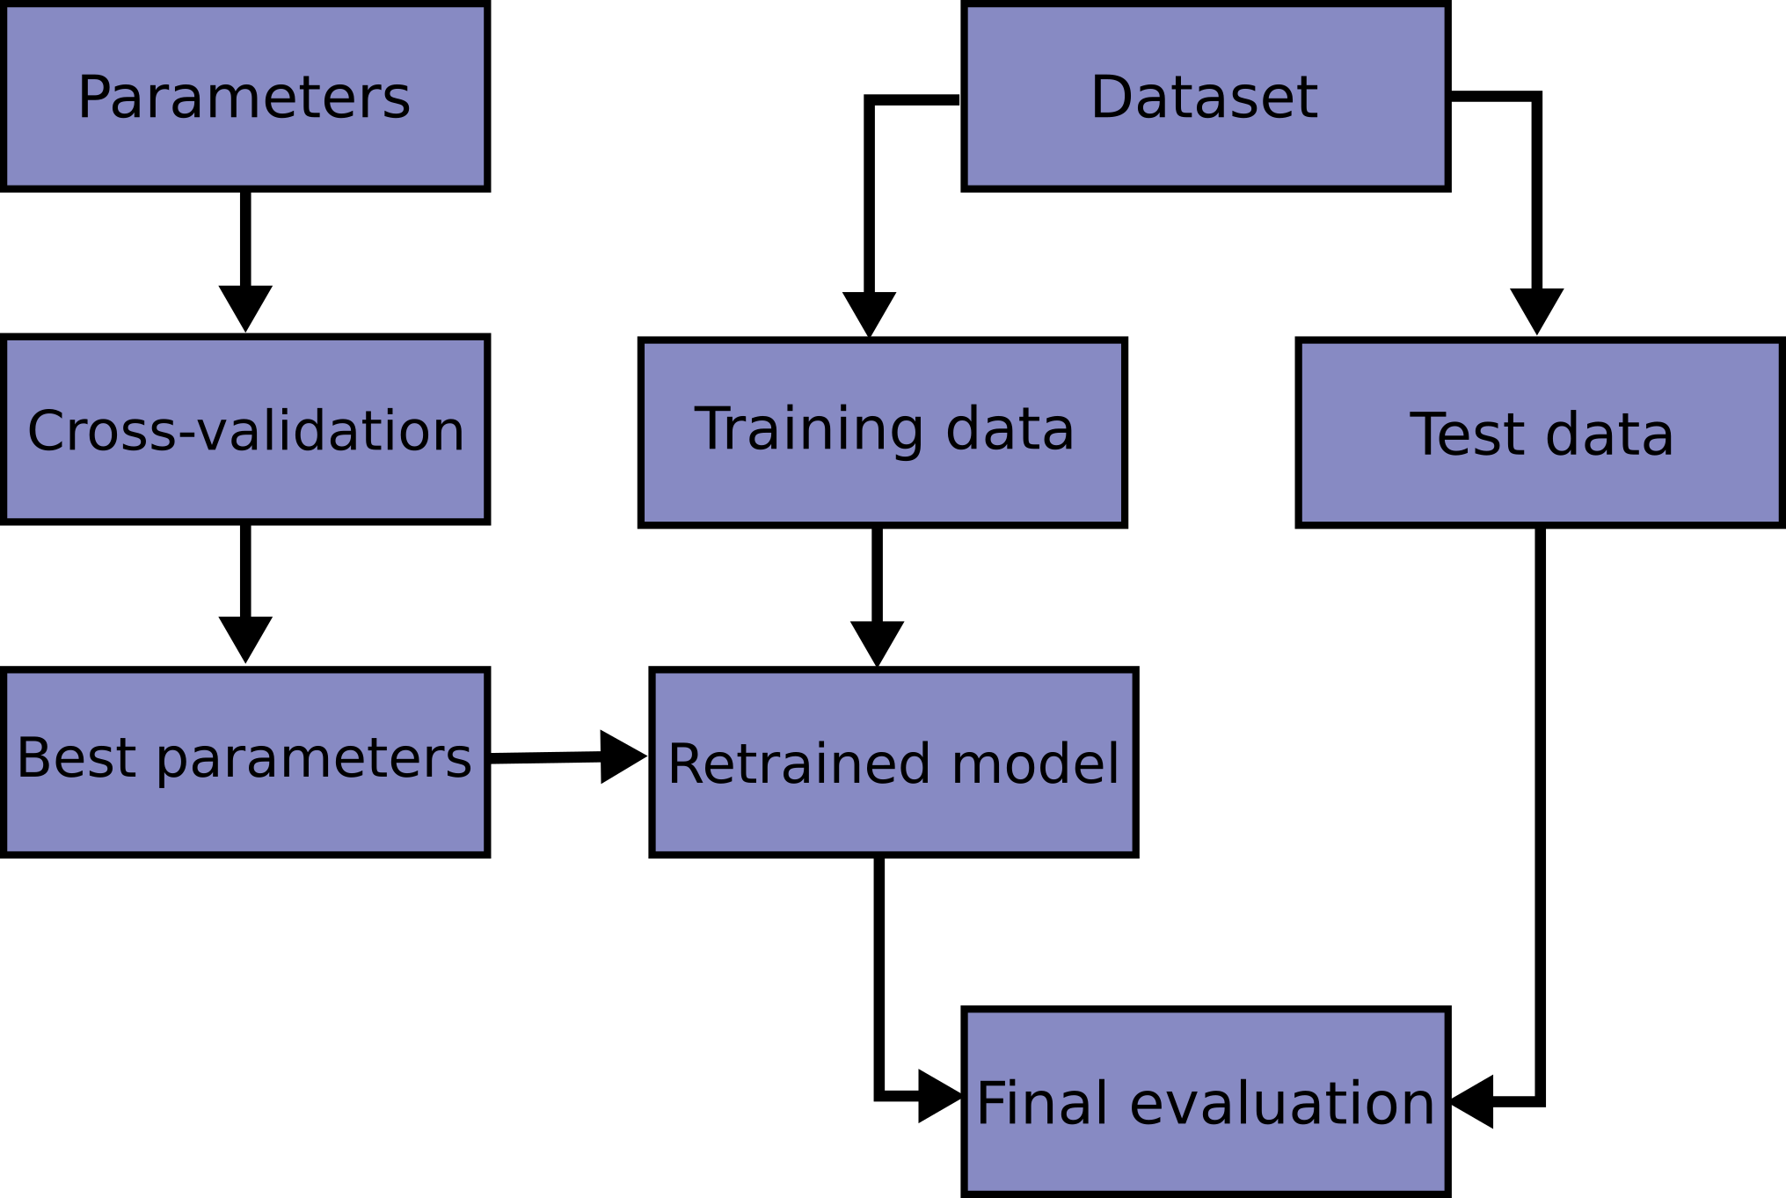

Approach 2: Cross validation
https://scikit-learn.org/stable/modules/cross_validation.html

Slide 36
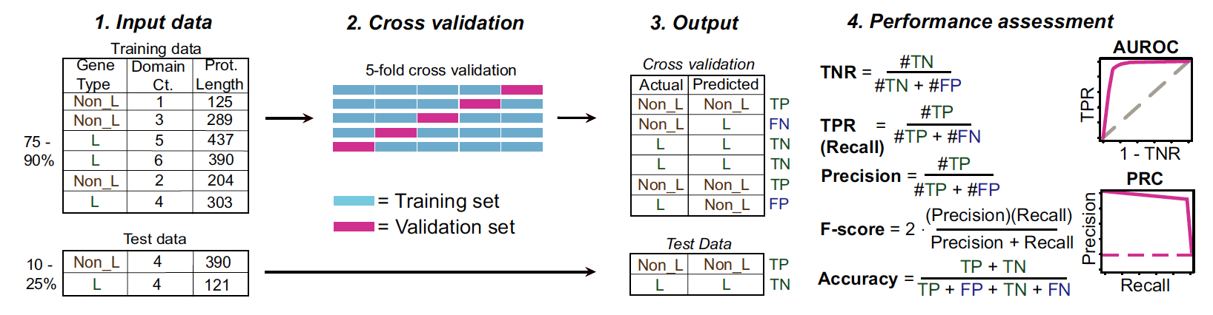
Example

Slide 37
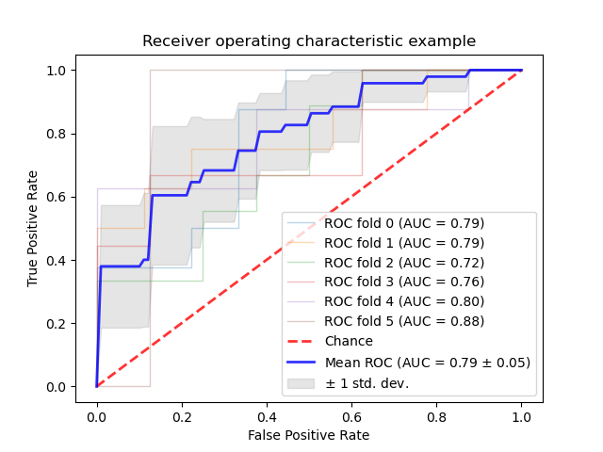
AUROC curve over multiple cv folds
For Random Forest, you may also come across another metric Out of Bag (OOB) error.
This metric is similar to cv (but not the same), and is specific to bagging approaches like RF

Slide 38
Estimating feature importance
Regression-based methods
Coefficients/weights of individual features as determined during learning
Tree-based methods
Gini impurity
Entropy
Information gain
Model independent
Permutation feature importance
Shapley values

Slide 39
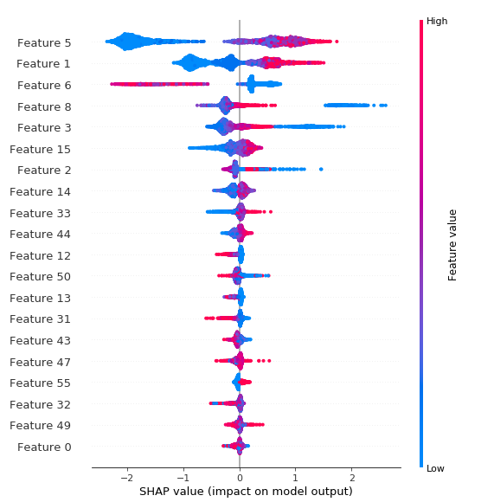
Shapley values
What is the impact of individual features on the classification of individual instances?
Each instance plotted
Effect of each feature on the prediction of each instance plotted
We can see the distribution of the effects
If High effect >> Red
If Low effect >> Blue

Slide 40
Recap
What is machine learning?
Statistics vs ML, Supervised vs. unsupervised
What does ML do?
Loss functions, Gradient Descent, Bias and Variance
Different algorithms for ML
Regression-based, tree-based, SVM, PCA, k-means clustering
How to estimate model performance and identify important features
Regularization, Cross-validation, feature-weights, Shapley Values
Examples of ML in Plant Science

Slide 41
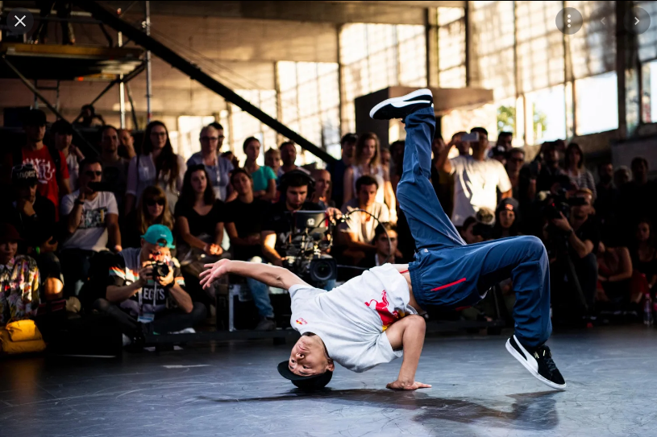
BREAK

Slide 42
Examples of ML in plant sciences
Gene
Evolution of duplicate genes
RNA
Long non-coding RNA prediction
Protein
Predicting ligand-binding sites of proteins
Metabolites
Next exercise
Phenotypes
Disease detection
Agricultural importance
Crop yield predictions

Slide 43
Learning goals
Learn to recognize the diversity of problems that can be addressed using ML
Realize what kind of data transformation and pre/post-processing is done
Put the learnt algorithms in context
Critique the papers

Slide 44
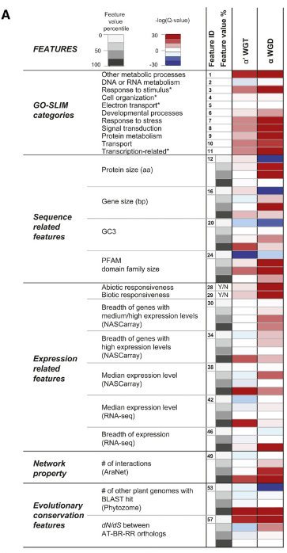
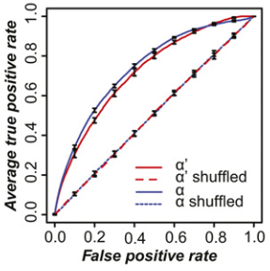

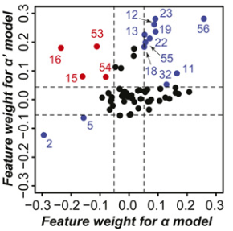
1. Evolution of duplicate genes
Can we predict whether genes would be retained or lost post-duplication?

Slide 45
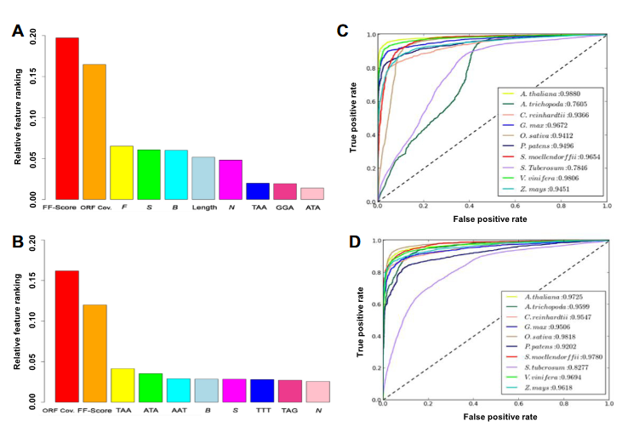
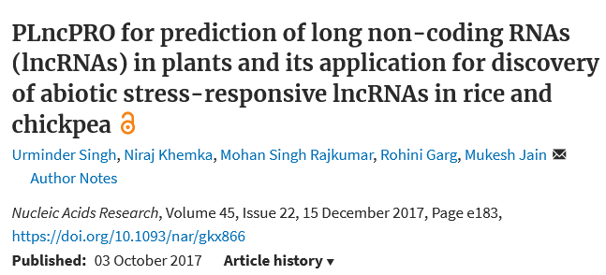
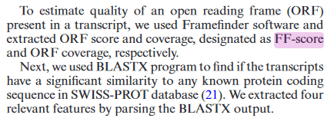
2. Predicting long non-coding RNA
Random Forest using 71 features

Slide 46
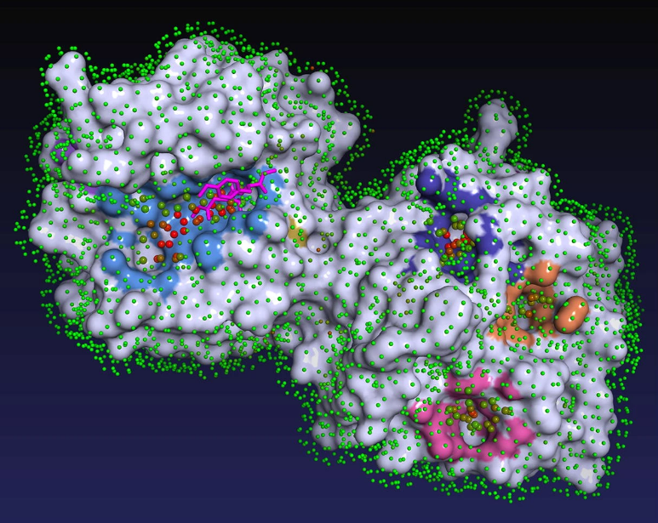
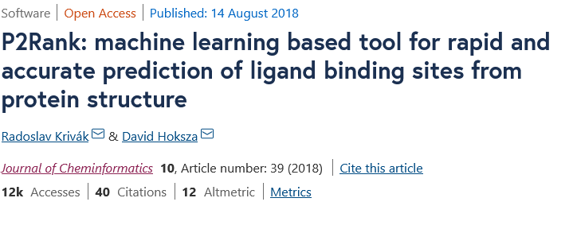
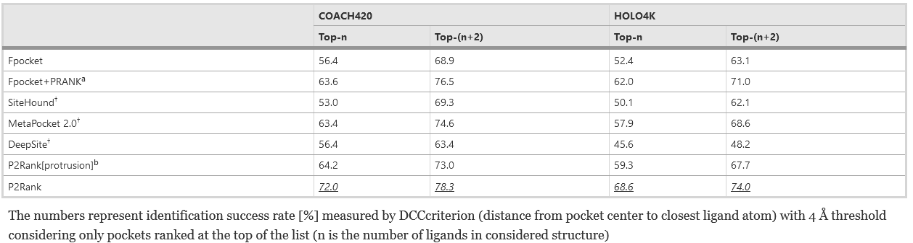
3. Predicting ligand binding sites
Random Forest
Predict Solvent Accessible Sites
Cluster them
Predict ligand binding site

Slide 47
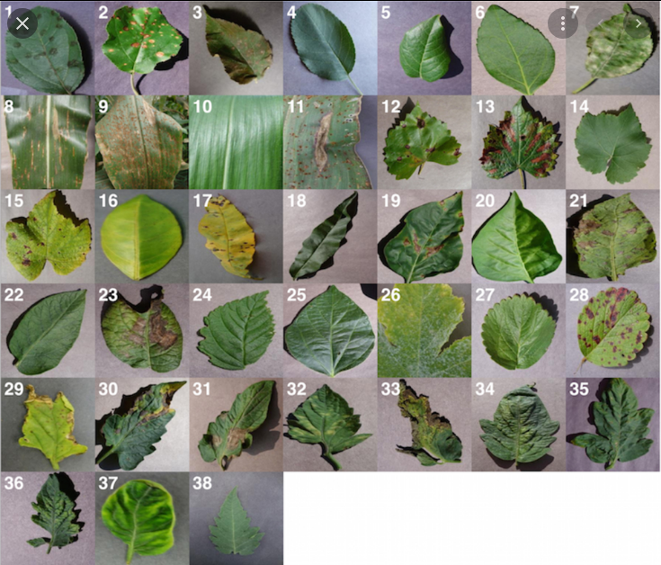
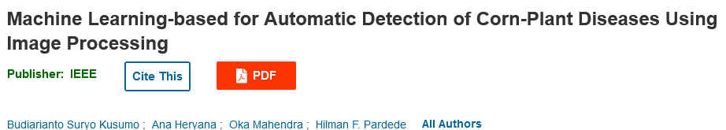
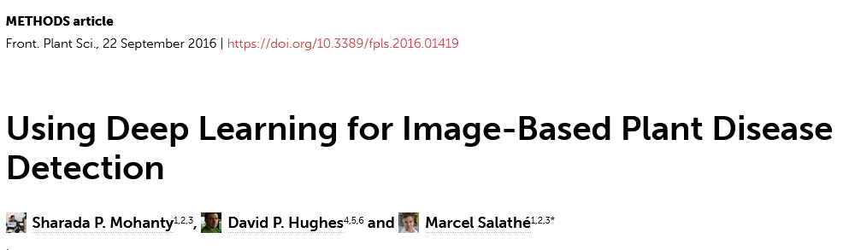
4. Detecting diseases on plant leaves
How to extract features from image data?

Slide 48
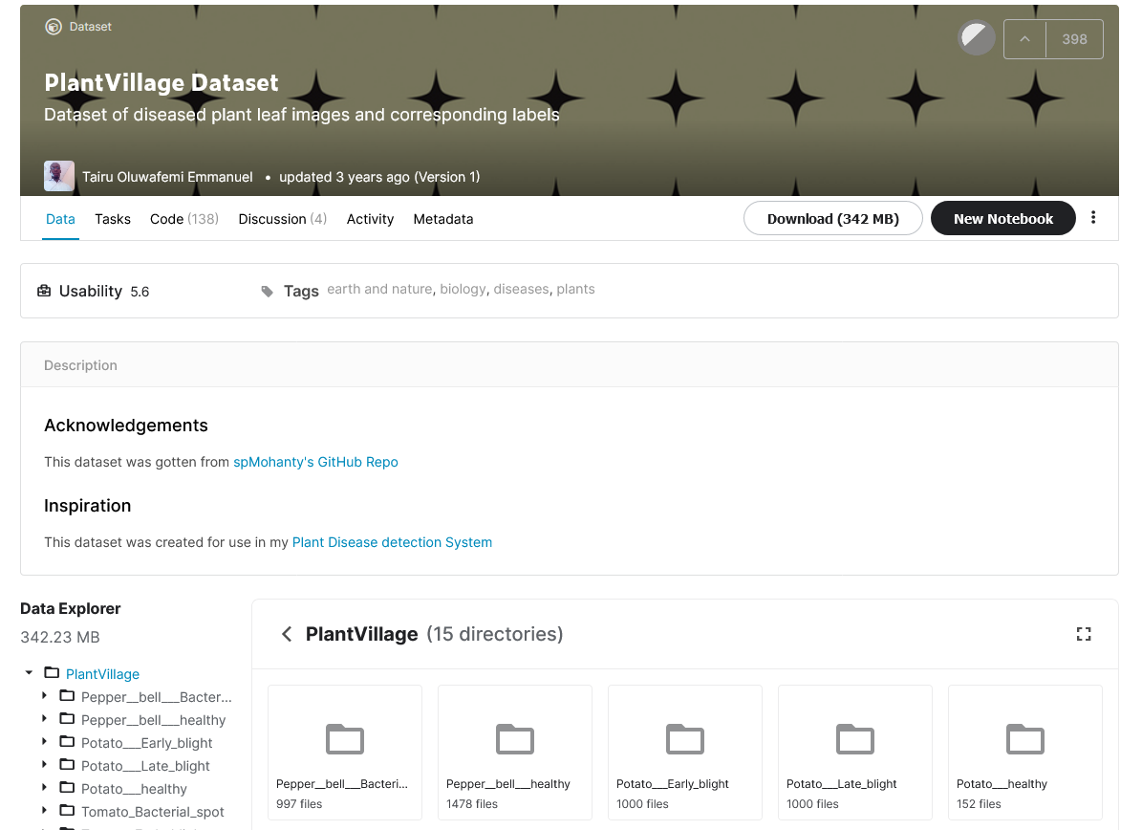
Plant Village dataset on Kaggle

Slide 49
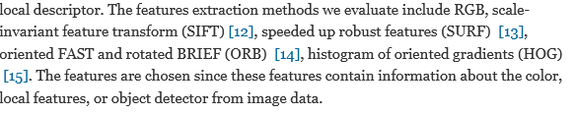
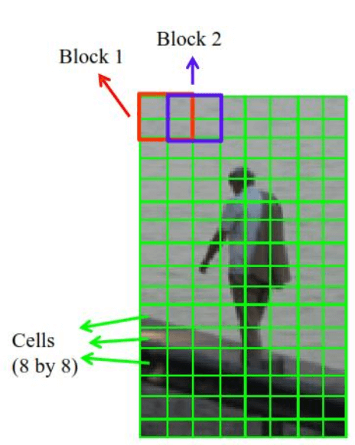
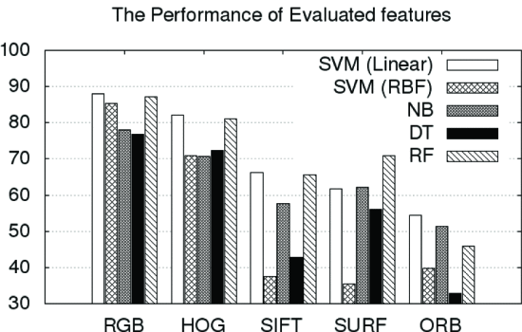
4. Detecting diseases on plant leaves
How to extract features from image data?
OpenCV library
Scikit-image library
HOG trans-formation
What is performance???!!!

Slide 50


5. Predicting crop yields
Regression application
Training Data
County level maize grain yield data from the US over a 30-year period
Potato tuber and maize yield from 13 states
Grain yield at global scale from all regions (International Maize and Wheat Improvement Center)

Slide 51
Common themes (student responses)

Slide 52
Next lecture
Feature Engineering
WEKA
Chemical compound classification
Activity:
Install WEKA on your own computers
Quiz on Canvas

